Slide 1
Zillow Home Value Prediction
Project by : SHIVIK AHUJA(12109784)
Pulkit Gupta(12109243)
Shivansh Sharma(12106075)

Slide 2
OUTLINE
1) Project summary
2) Technology used
3) Tools used
4) How it works?
5) What it does?

Slide 3
INTRODUCTION
Zillow is a real estate website that provides users with information about homes, including estimated home values. Zillow's home value estimates, also known as Zestimate, are based on a variety of factors, including the home's location, size, and features, as well as data from recent sales of similar homes in the area.
In recent years, there has been a growing interest in using machine learning to predict home values. Machine learning algorithms can be trained on large datasets of historical home sales data to learn the relationships between different factors and home values. Once trained, these algorithms can be used to predict the home values of new homes or to update the Zestimate of existing homes.

Slide 4
PROJECT SUMMARY
Our project is a machine learning app, based on certain specifications of your future home it will try to guess the most accurate price.
► Information such as state, city, area, stores.

Slide 5
Technology used
Machine Learning →
Tom Mitchell provides explained: "A computer program is said to learn from experience E with respect to some class of tasks T and performance measure P, if its performance at tasks in T, as measured by P, improves with experience E."
Example: playing checkers.
E = the experience of playing many games of checkers
T = the task of playing checkers.
P = the probability that the program will win the next game.

Slide 6
Example:
predicting whether the given object is pen or pencil??
E = the experience of predicting many pens and pencil.
T = the task of predict pen or pencil
P = the probability that of whether it is a pen or pencil

Slide 7
﻿ In general, any machine learning problem can be assigned to one of two broad classifications:
Supervised learning and Unsupervised learning.
1) Supervised Learning: - In supervised learning, we are given a data set and already know what our correct output should look like, having the idea that there is a relationship between the input and the output. Supervised learning problems are categorized into "regression" and "classification" problems.
2) In a regression problem, we are trying to predict results within a continuous output, meaning that we are trying to map input variables to some continuous function.

Slide 8
In a classification problem, we are instead trying to predict results in a discrete output. In other words, we are trying to map input variables into discrete categories.
Unsupervised Learning:-Unsupervised learning allows us to approach problems with little or no idea what our results should look like. We can derive structure from data where we don't necessarily know the effect of the variables. We can derive this structure by clustering the data based on relationships among the variables in the data. With unsupervised learning there is no feedback based on the prediction results.

Slide 9
Tools used:
PYTHON
TENSORFLOW
ANDROID STUDIO
ANACONDA

Slide 10
HOW IT WORKS?
COLLECTING DATA: FIRST STEP WAS TO COLLECT DATA WE COLLECTED DATA FROM DIFFERENT
SOURCES & MERGED THEM TOGETHER TO FORM OUR TRAINING DATA SET.
THEN WE TRAINED THE MODEL USING MACHINE
LEARNIG ALGORITHM WHICH IN THIS CASE IS MULTIPLE LINEAR REGRESSION.
BASED ON THE GENERATED GRAPHS WE PREDICT THE COST OF THE HOUSE

Slide 11
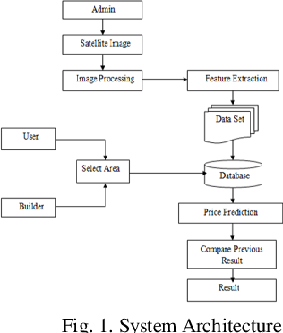

Slide 12
Future work
In a real world scenario, we can use such a model to predict house prices. This model should check for new data, once in a month, and incorporate them to expand the dataset and produce better results.
► We can try out other dimensionality reduction techniques like Univariate Feature Selection and Recursive feature elimination in the initial stages.
► We can try out other advanced regression techniques, like Random Forest and Bayesian Ridge Algorithm, for prediction. Since the data is highly correlated, we should also try Elastic Net regression technique.

Slide 13
THANKYOU!

